Slide 1

Hotel Bookings: „To Cancel or not to cancel“
Diana Jaffé Code Academy
June 11,2021

Slide 2
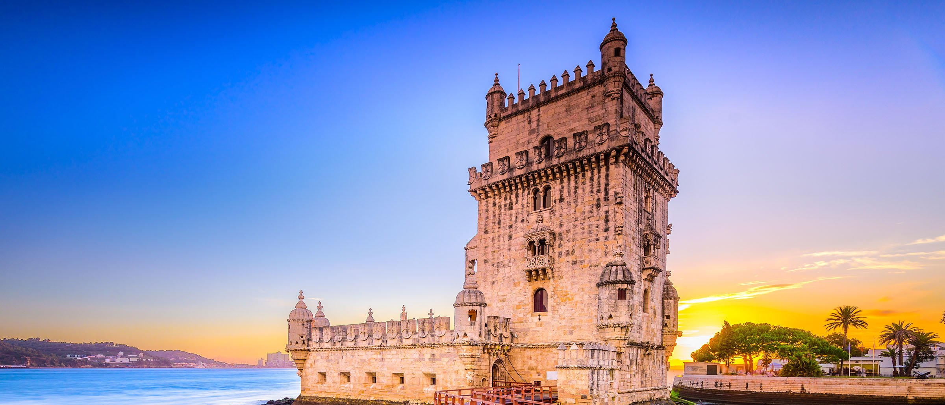
Hotel Bookings: „To Cancel or not to cancel“
Diana Jaffé Code Academy, 06/11/2021

Slide 3
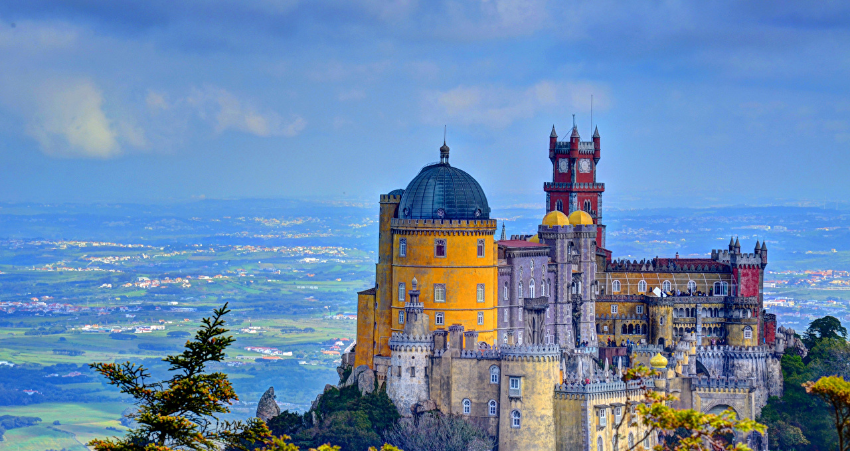
Hotel Bookings: „To Cancel or not to cancel“
Diana Jaffé Code Academy, 06/11/2021

Slide 4
HOTELs: „To cancel or not to cancel“
Where does the data come from?
A tiny little bit about the Portugese travel market.
Hidden secrets in the data.
Machine Learning: Can „the machine“ foretell people‘s behavior?

Slide 5
the portugese touristic Market - 2018
Tourism made 8.52% of the Portugese GDP in 2018.
International travelers make 71% of the 57.6m overnight stays in hotels.
This equals 12.7m arrivals of international guests.
Overnight stays in hotels have dropped in a range from 1% - 5% since 2016.
RevPAR has nevertheless increased.

Slide 6
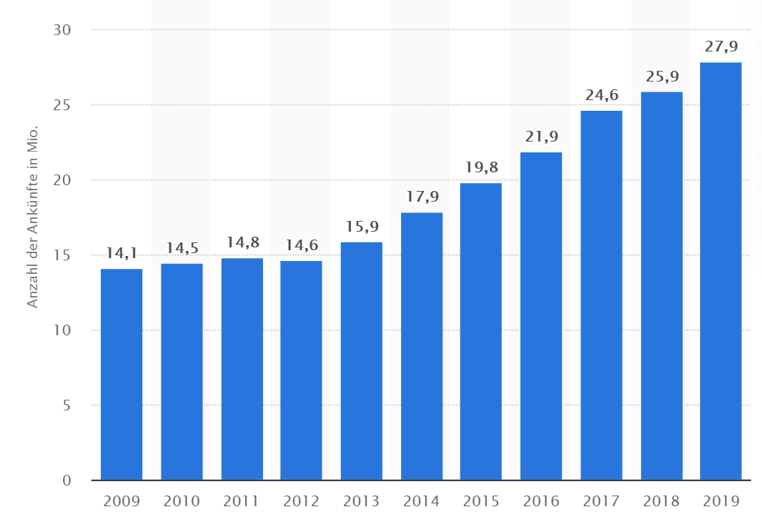
tourist arrivals AT accomodation providers in Portugal 2009 -2019 IN Mio.

Slide 7
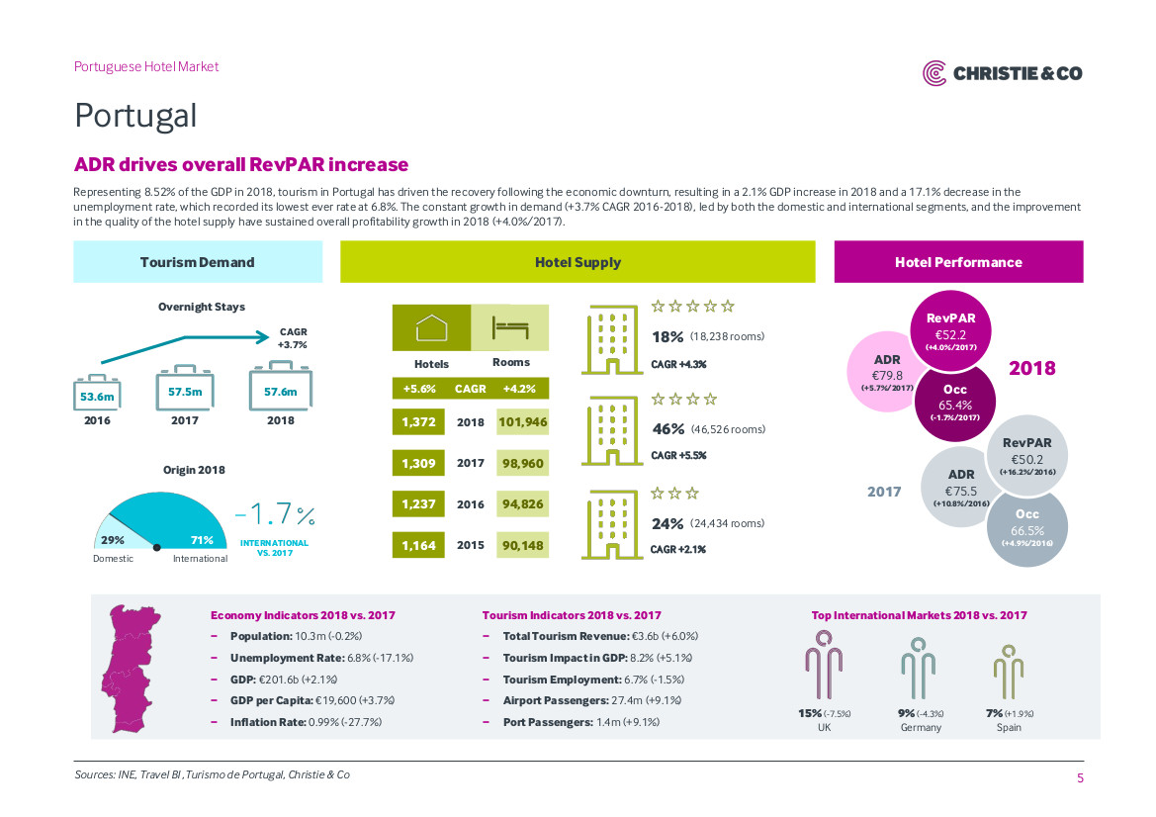

Slide 8
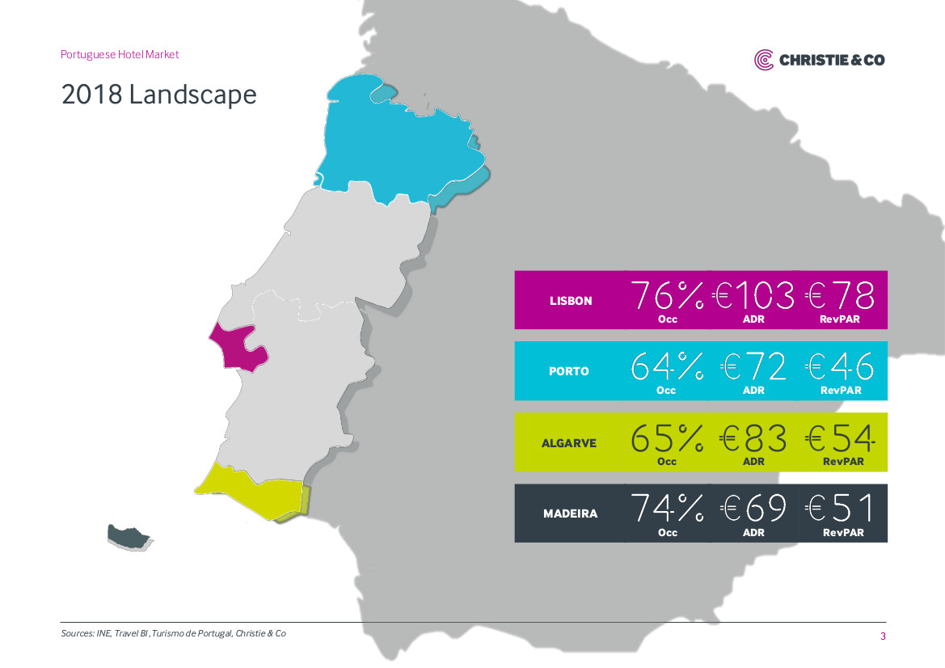

Slide 9

THE Beauty - of data
Good Data Paints A Picture Of The World.

Slide 10

THE Beauty - of data
Good Data Paints A Picture Of The World.

Slide 11
Possible kpi s

Slide 12
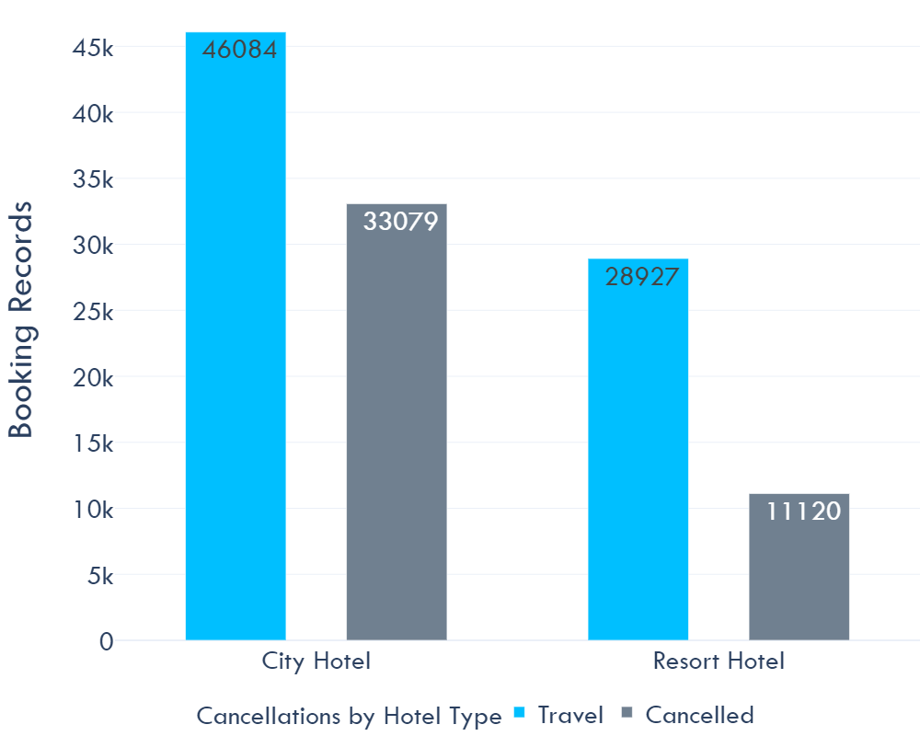
Data structure

Slide 13
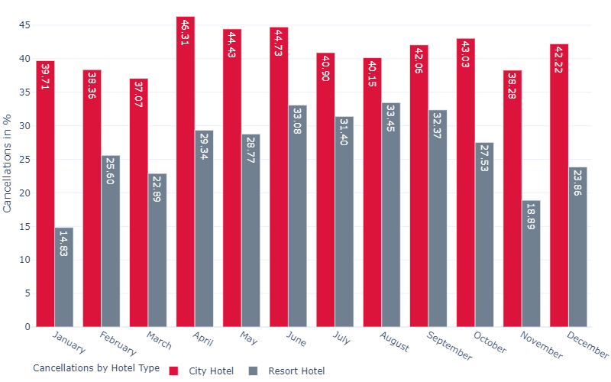
CANCELLATion Rate per month in %

Slide 14
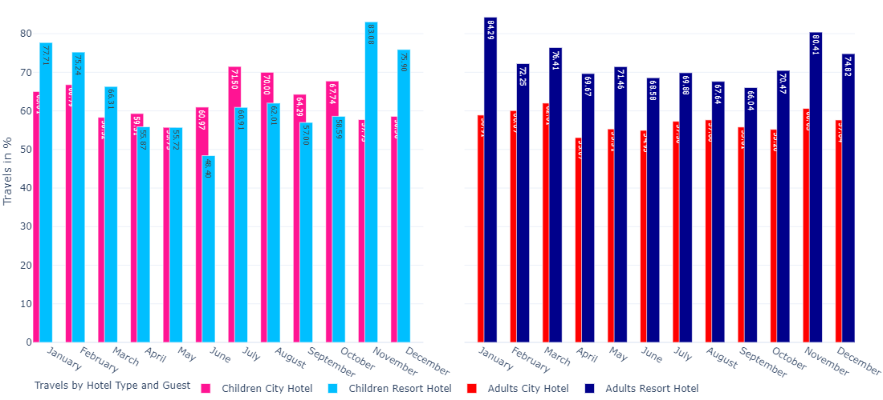
Travel Rate (positive for no cancellation)

Slide 15


Slide 16
Life begins Where the data ends
Questions:
What are the reasons for the vast cancellation rates for resort hotels in summer of families with children?

Slide 17
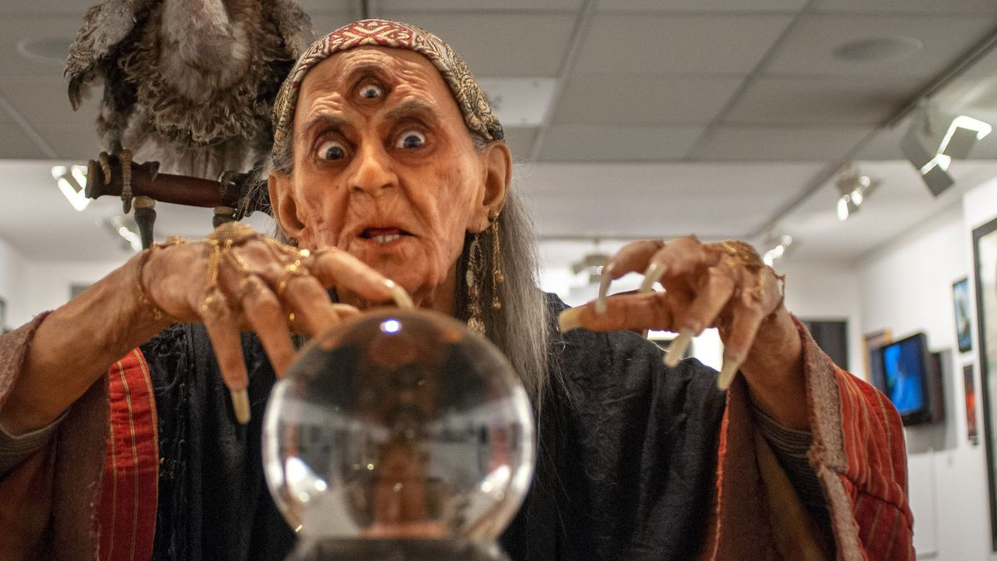
Is „the machine“ a fortune teller?

Slide 18
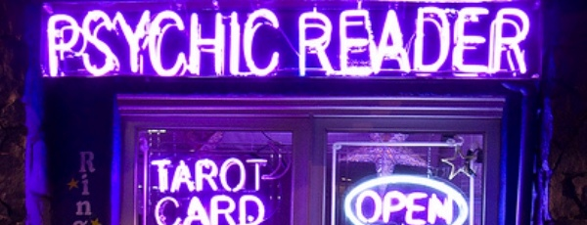
Is „the machine“ a fortune teller?

Slide 19
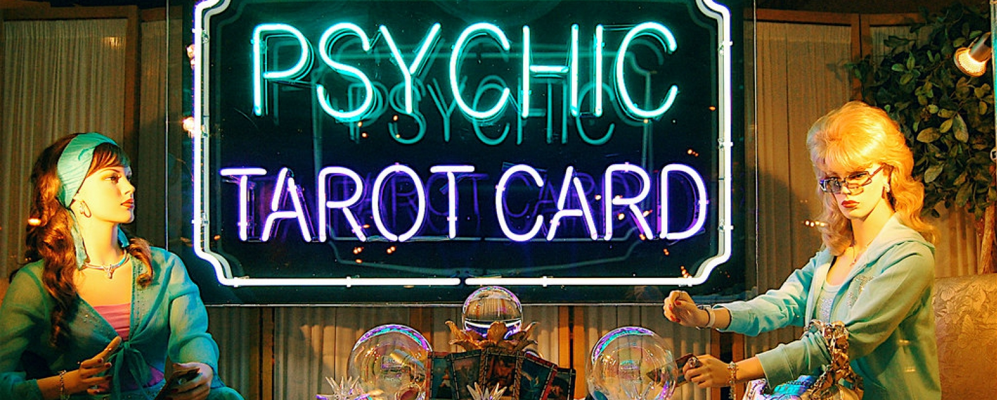
Is „the machine“ a fortune teller?

Slide 20

Is „the machine“ a fortune teller?

Slide 21

Can a machine predict people‘s behavior in the future?

Slide 22
Trying to tackle the cancellation question
 | MODEL | SCORE | KAPPA
1 | Random Forest Classifier | 0.891871 | 0.765818
2 | Decision Tree Classifier | 0.855423 | 0.691746
3 | KNN | 0.835123 | 0.643846
4 | K-Fold Decision Tree Classifier | 0.819173
5 | Logistic Regression | 0.792928 | 0.529230

Slide 23

„Nice. But you can do better.“
Accuracy > 90 %
Kappa > 80%

Slide 24
And I tried harder…
Strategies
Classification Methods
Standardization
Normalization
Dummification
Outlier deletion
Correlation Matrix
Feature selection
Splitting hotel data
Different random states.
Logistic Regression
Decision Tree
K-Fold Decision Tree
KNN
Random Forest
Ada Boost Classifier
Gradient Boosting Classifier
XgBoost Classifier
Cat Boost Classifier
Extra Trees Classifier
LGBM Classifier
Voting Classifier

Slide 25
Trying to tackle the cancellation question
 | MODEL | SCORE | KAPPA
1 | Random Forest Classifier | 0.894053 | 0.770164
2 | Extra Trees Classifier | 0.889774 | 0.759985
3 | Voting Classifier | 0.879414 | 0.735213
4 | Cat Boost | 0.876730 | 0.733468
5 | XgBoost | 0.868258 | 0.714031
6 | LGBM | 0.863476 | 0.706467
7 | Decision Tree Classifier | 0.856094 | 0.693108
8 | Gradient Boosting Classifier | 0.849425 | 0.668910
9 | KNN | 0.835794 | 0.646068
10 | Ada Boost Classifier | 0.838520 | 0.644882
11 | Logistic Regression | 0.794313 | 0.535256

Slide 26
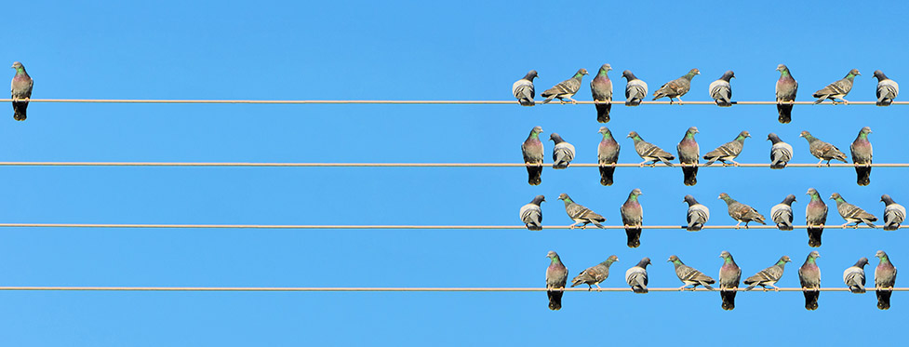
The Problem: imbalanced data

Slide 27
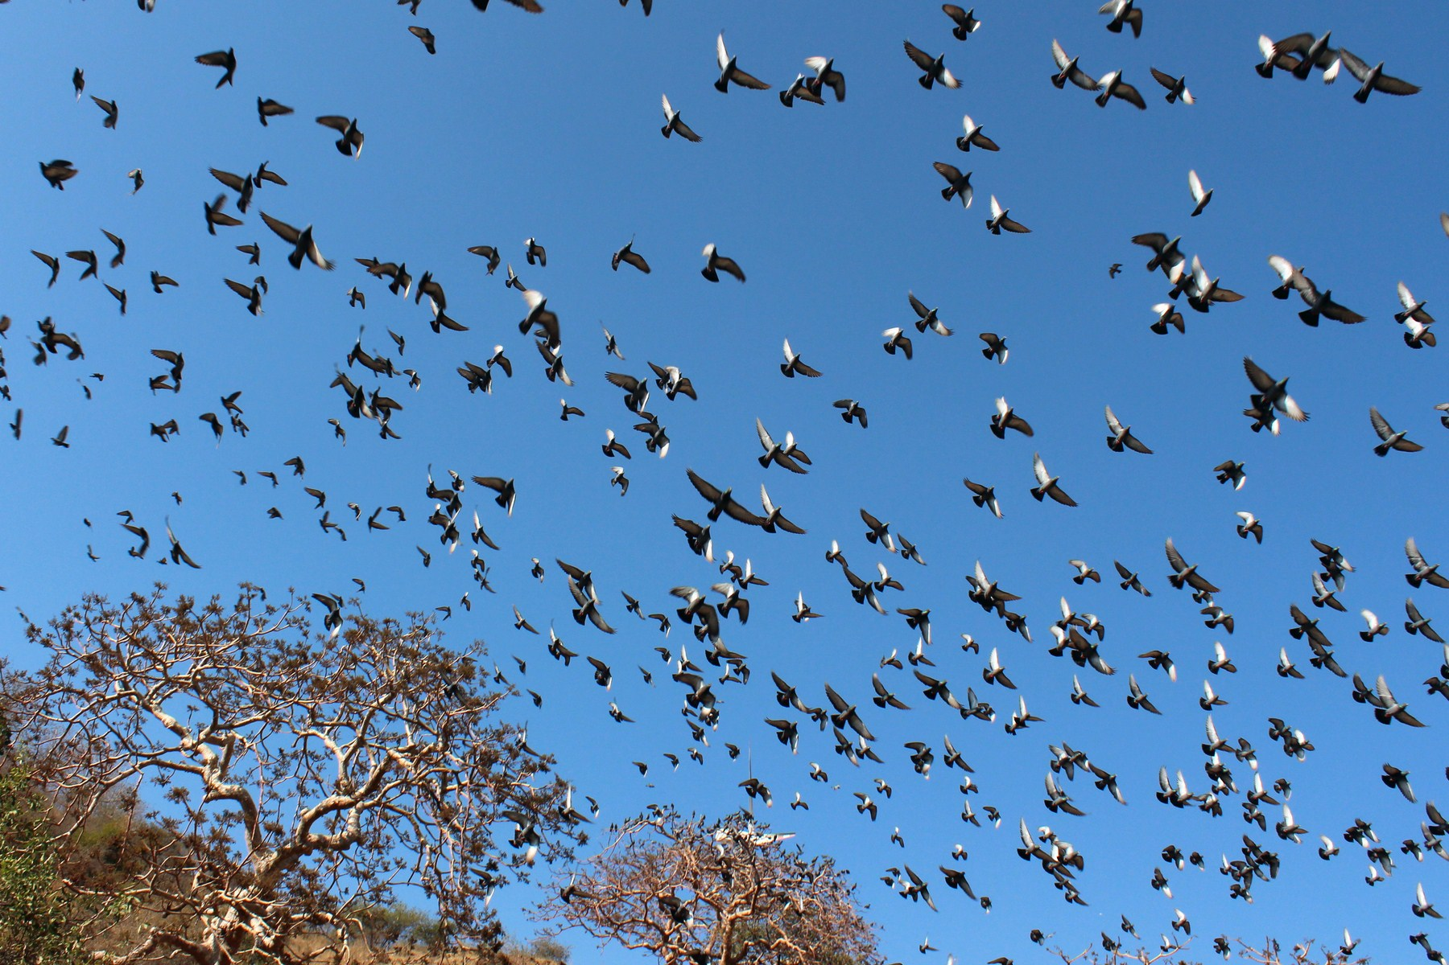
The solution: oversampling with smote

Slide 28
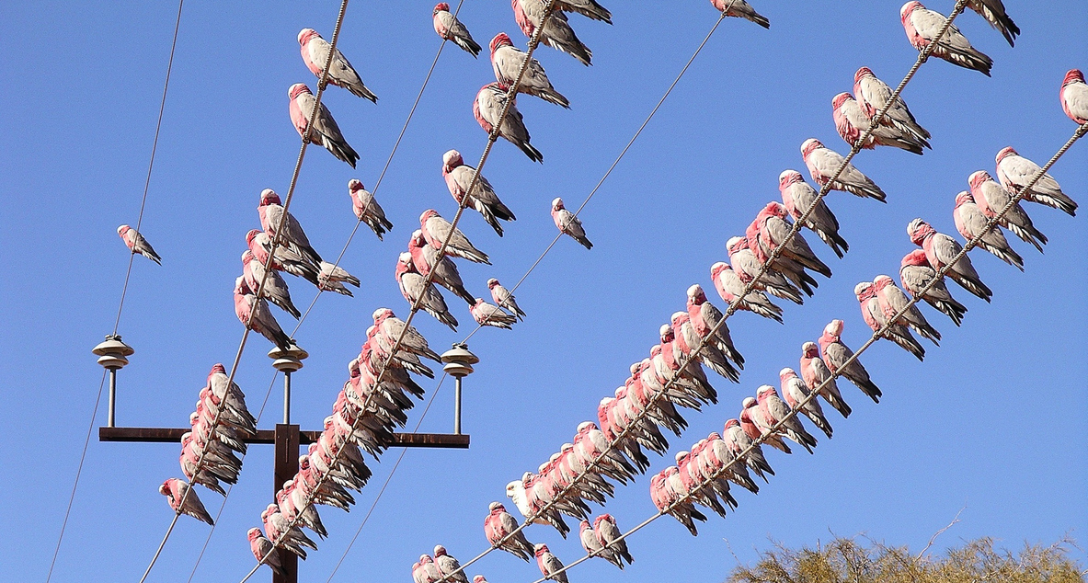
The solution: oversampling with smote

Slide 29
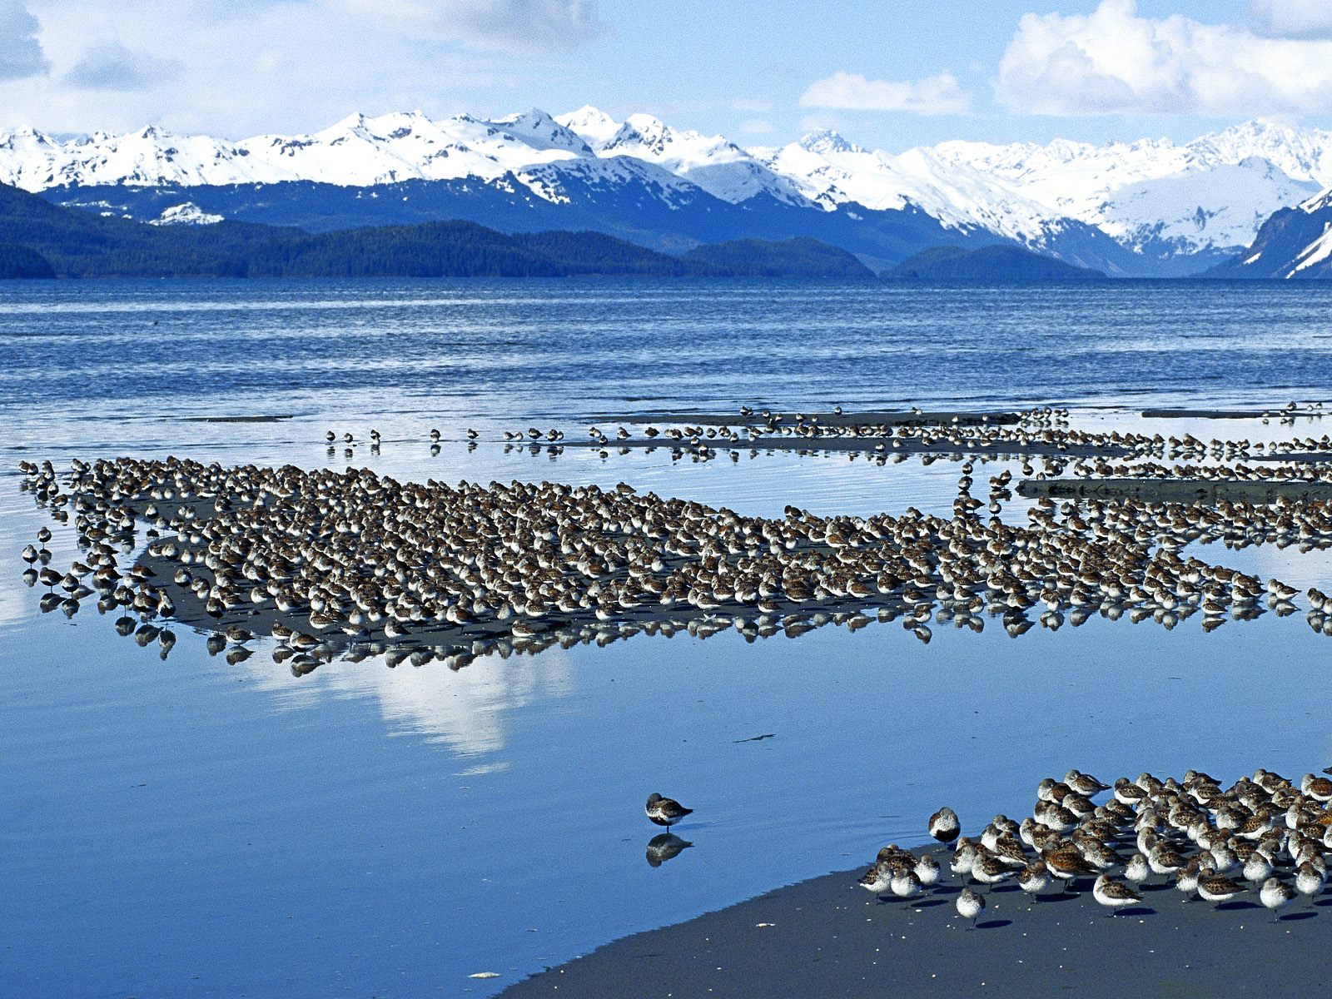
The Problem: imbalanced data

Slide 30
The solution: oversampling with smote

Slide 31
Oversampling with smote
SMOTE is an oversampling algorithm that relies on the concept of nearest neighbors to create its synthetic data. Proposed back in 2002 by Chawla et. al., SMOTE has become one of the most popular algorithms for oversampling.
The simplest case of oversampling is simply called oversampling or upsampling, meaning a method used to duplicate randomly selected data observations from the outnumbered class.
Oversampling’s purpose is for us to feel confident the data we generate are real examples of already existing data. This inherently comes with the issue of creating more of the same data we currently have, without adding any diversity to our dataset, and producing effects such as overfitting.
Hence, if overfitting affects our training due to randomly generated, upsampled data– or if plain oversampling is not suitable for the task at hand– we could resort to another, smarter oversampling technique known as synthetic data generation.

Slide 32
Finally THE Miracle…
 | MODEL | SCORE | KAPPA
1 | Random Forest Classifier | 0.931811 | 0.863627
2 | Extra Trees Classifier | 0.930645 | 0.861290
3 | K-Fold Decision Tree | 0.811953 | 0.811953
4 | Decision Tree Classifier | 0.904816 | 0.809642
5 | Voting Classifier | 0.894484 | 0.788964
6 | Cat Boost | 0.876487 | 0.752982
7 | XgBoost | 0.870488 | 0.740984
8 | LGBM | 0.866389 | 0.732787
9 | KNN | 0.842260 | 0.684540
10 | Gradient Boosting Classifier | 0.840927 | 0.681851
11 | Ada Boost Classifier | 0.839293 | 0.678582

Slide 33
What Is Revenue Per Available Room (RevPAR)?
Revenue per available room (RevPAR) is a metric used in the hospitality industry to measure hotel performance. The measurement is calculated by multiplying a hotel's average daily room rate (ADR) by its occupancy rate. RevPAR is also calculated by dividing a hotel's total room revenue by the total number of available rooms in the period being measured.

Slide 34

Thank you
Diana Jaffé Code Academy
June 11,2021

